Slide 1
Volunteering at the Oregon Food Bank
By Sharath Menon
Effecting Change

Slide 2
About the OFB:
The Oregon Food Bank is an organization dedicated to eliminate hunger, especially towards homeless and very low-income families. The organization’s main goal is to eliminate all hunger in the state of Oregon, and have Oregon be the first U.S. state without any hunger.
Mission Statement: To eliminate hunger and its root causes because no one should go hungry.

Slide 3
Some famous quotes:
"A nation's greatness is measured by how it treats its weakest members." - Mahatma Ghandi
"A society will be judged by how it treats its weakest members." - Harry S. Truman
“A society will be judged on the basis of how it treats its weakest members; and among the most vulnerable are surely the unborn and the dying.” - Pope John Paul II

Slide 4
Homeless problem in Portland:
Portland’s reputation has been marred and tarnished by the poor treatment of its homeless population. Homeless camps are too full, forcing many homeless to take shelter underneath a bridge. This leaves an immense scar on Portland’s tourism and appearance.

Slide 5
Frightening Fact
Dave Smith in 2017
Dave Smith in 2015
This homeless man...
was an average working man, living a comfortable life, two years ago.
YOU could be far closer to being homeless than you think!ALL IT TAKES IS TO LOSE YOUR JOB, NOT PAYING TAXES, OR SURRENDERING TO AN ADDICTION.
We should change our perception of homeless people. We never know that kind of history they’ve been through.

Slide 6
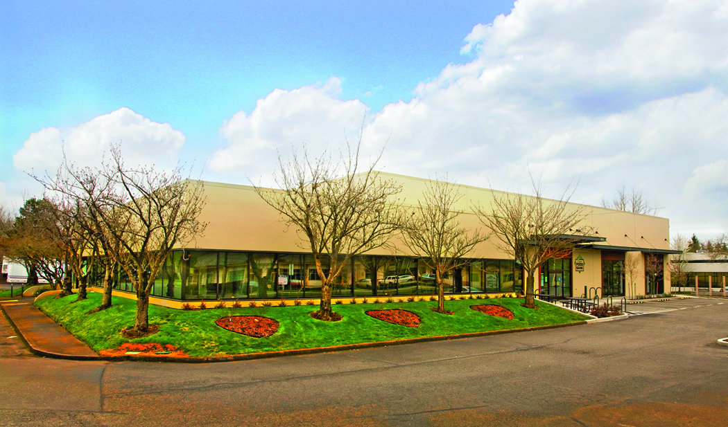
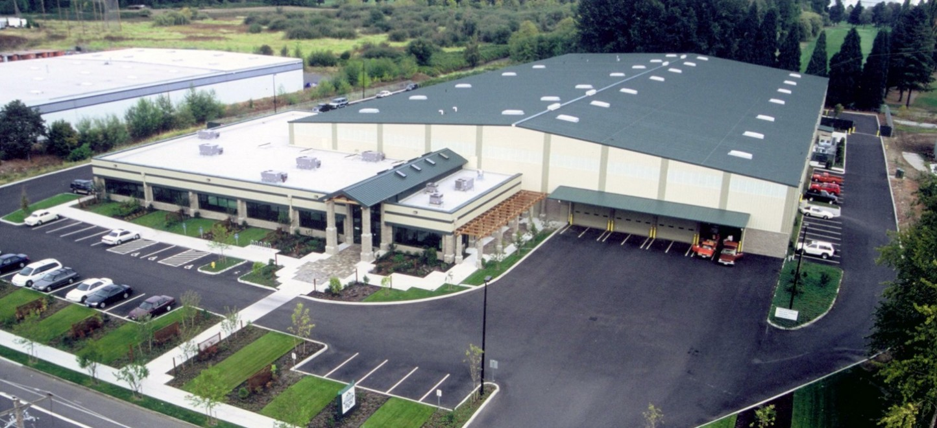
Locations:
Beaverton Office:
1870 NW 173rd Ave. Beaverton, OR 97006
Portland Office:
900 NE 33rd Dr. Portland, OR 97211

Slide 7
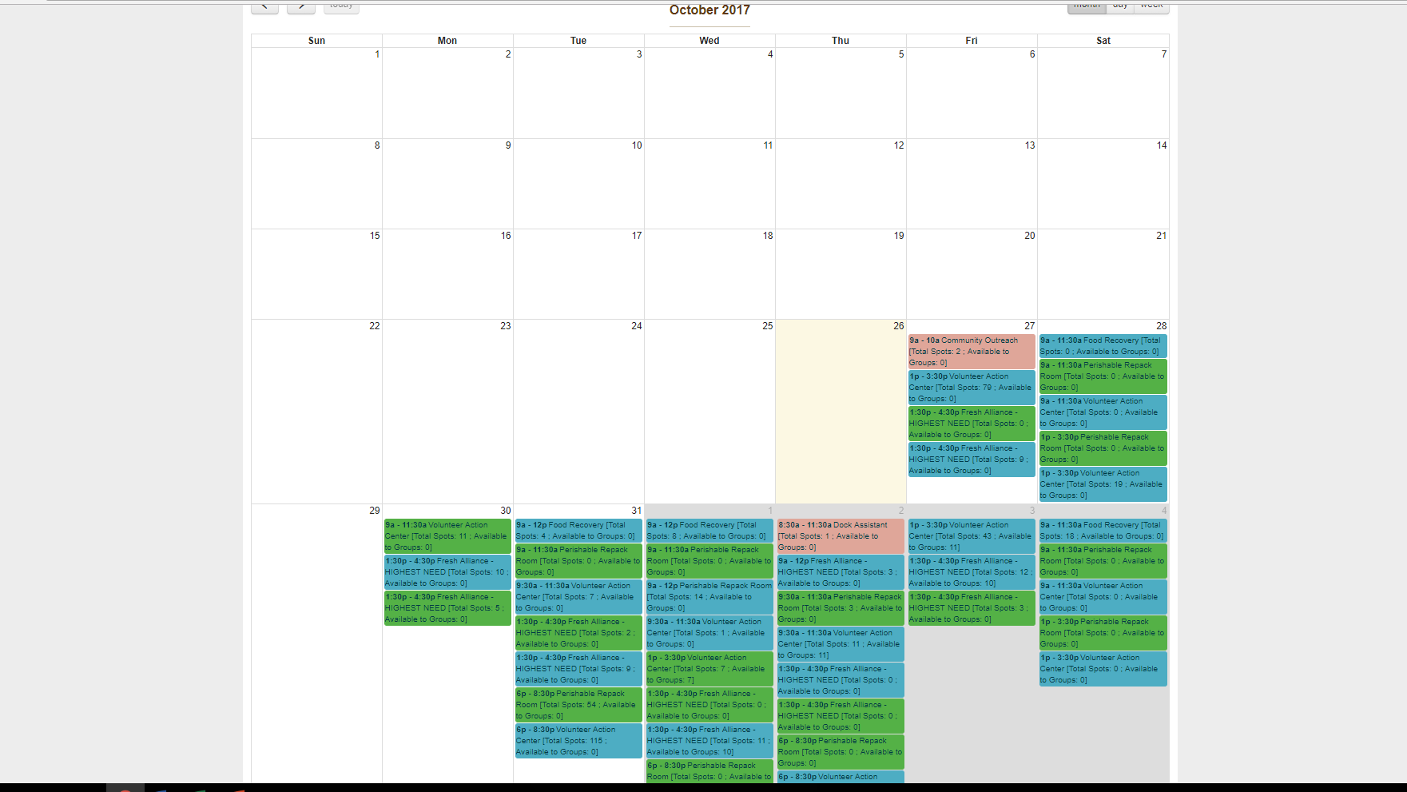
Volunteering Schedule:

Slide 8
Types of volunteering jobs:
Fresh alliance
Pack thousands of pounds of frozen vegetables into boxes.
Perishable repack
Packaging food that is near or just past the expiration date

Slide 9
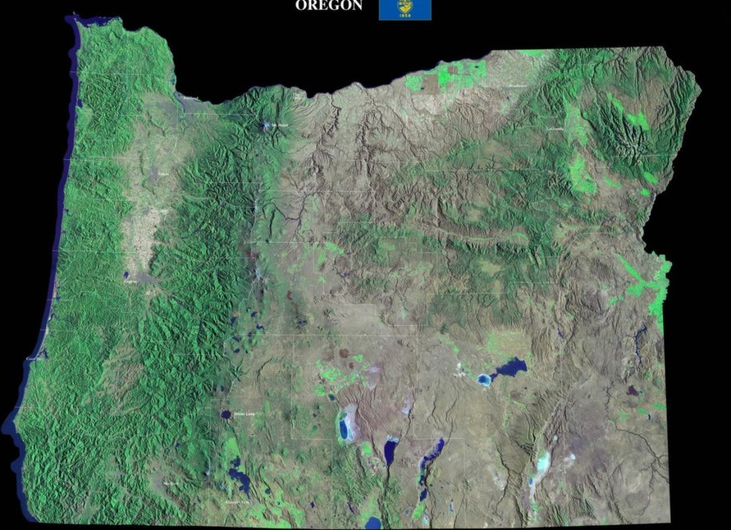
Some Geography:
Much of Oregon’s landmass is arid
There is not much arable land in Oregon.
Most of Oregon’s population lives within 100 miles from the coast.
Where much of the land is very lush and green, due to heavy rainfall.
Eastern Oregon receives little rainfall, thus having an arid climate.
Most of the population is confined to the Willamette Valley. Very arable and fine land including Portland, Salem, and Eugene.
Climate and geography is an important factor for farming.
Being a coastal city with arid elements, Portland’s weather can get very warm for its latitude.
Oregon’s climate is a warm summer mediterranean climate. Hot summers and rainy winters characterize this climate.
Oregon is famous for multiple berries.
The widely recognizable Marion berry named after Marion County, Oregon.

Slide 10
Some Math:
Helping by the numbers
“Fun” fact: Approximately half of all US food produce goes to waste.
By 2019, OFB looks to distribute over 15M lbs. of food.
Each day, this translates to over 41,000 lbs. of “recycled” food.
In a day, an average healthy person consumes between 3 lbs. and 5 lbs. of food a day.
The daily amount of would-be thrown out, but still perfectly okay to eat, food is enough to feed around 10,300 healthy people in a day, or:
A healthy male for 24 years!
A healthy female for 35 years!
The next time you throw out food that could be eaten, let these stats sink in!

Slide 11
Benefits of Volunteering at OFB:
Get to help multiple families.
Signing up is not arduous.
Quick and easy volunteering hours.
Food handlers card is not required.
Most employees are friendly and lenient.
Receive gifts depending on how many hours worker.
20 hours = name tag
100 hours = t-shirt
200 hours = mug
300 hours = jacket
Thousand of hours or years of volunteering = government recognition
Beaverton location
Nice overall location
Larger work area
More laid back environment, good for beginners.
Portland location
More upbeat environment
More experienced employees
Serves as the “headquarters” of the Oregon Food Bank, therefore gets more support.

Slide 12
Disadvantages of Volunteering at OFB:
Not a paid job (unless you’re a director there).
Work in cold working conditions (room is around -5C to 10C (23F to 50F))
Warm clothing is required
Food safety is EXTREMELY important.
Sanitation is taken VERY seriously, as you’re working with food to be delivered to the public.
Some jobs can be risky, meant for adults.
Must have a food handler’s card or have lots of volunteering hours for these jobs.
Many “basic” jobs are off limits to kids, such as working with cutting tools and tape.
Beaverton location
Much younger working group (lots of middle and high school students).
Smaller overall office compared to Portland.
Much less supervision when working with heavy or dangerous equipment.
Portland location
Rough area of Portland.
Smaller work environment (despite having a larger office).
Hard to commute. Traffic and shabby roads could make it a challenge.

Slide 14
Credits:
Kgw - 6 Reasons Why Portland’s Homeless Crisis is at a Breaking Point <http://www.kgw.com/news/investigations/6-reasons-why-portlands-homeless-crisis-is-at-a-breaking-point/156737977>
Oregon Food Bank <https://www.oregonfoodbank.org/>

