Slide 2
CAD Exercise Adaptations
Can participants in primary or secondary prevention programs really expect improvements?
YES
Central and peripheral CV system improvements
Skeletal muscle system improvements
CAD risk factor improvement

Slide 3
Diabetes Exercise Prescription
Type II:
Blood glucose monitoring
In those taking oral hyperglycemic agents
Management of obesity (calorie expenditure)
Increased duration and frequency - 5-7 times per week
promotes weight loss and sustained increase in insulin sensitivity
Lower intensity (~50% VO_{2max})
Same improvement in insulin sensitivity as higher intensities
Especially in those with retinopathy or comorbidities

Slide 4
Diabetes Management
Resting BP < 130/80mmHg
Exercise testing to detect silent ischemia
Keep exercise BP low (retinopathy)
Blood glucose:
Fasting levels managed
Type I – pre-exercise blood glucose >100mg/dl
Type II – pre-exercise blood glucose <300mg/dl and < 250mg/dl with ketones

Slide 5
Cardiorespiratory Endurance
Maximal Exercise Adaptations
Central adaptations (10-30% increase)
↑stroke volume, cardiac output, and VO₂max
Peripheral adaptations
↑extraction & utilization of oxygen
occurs sooner than stroke volume changes
Submaximal Exercise Adaptations
↓ submaximal HR, ↑ SV and oxygen extraction

Slide 6
Cardiorespiratory Endurance
Submaximal Exercise Adaptations
↓ submaximal HR @ same VO₂
↑ energy expenditure at same HR
↓ myocardial stress during exercise
due to decreases in both HR and BP (Rate Pressure Product - RPP)
IMPORTANT for CAD patients that have a specific ischemic threshold to watch for
Rest Adaptations
↓ resting HR, ↑ stroke volume

Slide 7
Cardiorespiratory Endurance
CAD Risk Factor Changes
Hard to predict how much is due to exercise:
individual variability
other factors - nutrition, body composition changes, etc.
Blood Lipids
increases HDL, decreased LDL & triglycerides
Blood Pressure
reduced systolic and diastolic BP

Slide 8
Resistance Training
Goals:
improve muscular strength and endurance, maintain lean mass during weight loss, maintain or improve function with aging
15-30% improvements in muscle strength and endurance
depending on training volume and initial values
Health-related improvements
support changes from cardiorespiratory training exercise
maintaining functional independence with age

Slide 9
Exercise and Type 1 Diabetes

Slide 10
Why We Lose Strength With Age
↓ Fast-twitch (Type II) fibers
↓ Fiber size – reaches max size at 20 years old
can be maintained to through age 60
↓ Distinction between Type I & II fibers (Collateral Sprouting)
↑ Injury & inflammatory response
↓ Capillarization – changes muscle blood flow
↓ Metabolic enzymes
↓ Protein synthesis rates
calcium channels for SR-Ca⁺⁺ release
↓ Motor units with age
-1% per yr in 30’s
↓ Muscle contraction velocity

Slide 11
Resistance Training Improves Strength in Elderly
81-93 year olds were tested
Given a high intensity resistance training program
3x/week for 8 weeks
RESULTS:
leg strength ↑ 147 - 180%
gait velocity ↑ 48% (distance/stride of walking)
stair climb power ↑ 28%
thigh muscle area ↑ 11%
Fiatarone et al., JAMA, 1990; Fiatarone et al., NEJM, 1994

Slide 12
Why We Lose Strength With Age
↓ Fast-twitch (Type II) fibers
↓ Fiber size – reaches max size at 20 years old
can be maintained to through age 60
↓ Distinction between Type I & II fibers (Collateral Sprouting)
↑ Injury & inflammatory response
↓ Capillarization – changes muscle blood flow
↓ Metabolic enzymes
↓ Protein synthesis rates
calcium channels for SR-Ca⁺⁺ release
↓ Motor units with age
-1% per yr in 30’s
↓ Muscle contraction velocity

Slide 13
Joint Health
Rheumatism
Pain & stiffness in joints & muscles
Arthritis
Rheumatic diseases that affect synovial joints
Osteoarthritis
Degenerative arthritis
Rheumatoid arthritis
Inflammatory arthritis, immune system

Slide 14
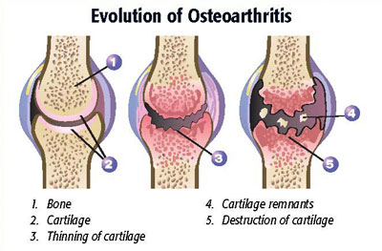
Osteoarthritis
A degenerative joint disease:
changes in the underlying bone to changes in the hyaline cartilage of the synovial joints
Symptoms include:
-inflammation
-ligament laxity
-weak muscles
around the joint

Slide 15
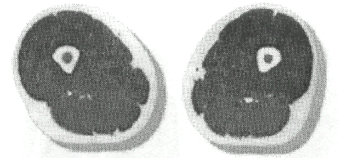
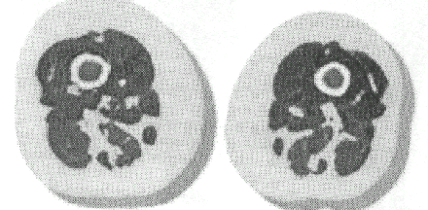
Sarcopenia
Literally means: poverty of flesh
Sarcopenia is the term used to describe the age-associated changes to skeletal muscle
10% loss in mass by age 50
50% loss in mass by age 80
Ex: Age 25 / athlete
Ex: Age 64 / sedentary

