Slide 1
Healthy Relationships

Slide 2
Expect Respect
Healthy relationships always hold the element of respect
Disrespect in a relationship is never okay no matter how mad, hurt, or worried the other partner feels
Respect informs the way we handle disagreements, take the other person’s feelings into considerations, and how we treat them
Respect needs to be present in order for positivity to thrive in the relationship
We All Deserve Respect No Matter What
We all make mistakes
We all have done “bad” things
That doesn’t excuse others from treating us with respect

Slide 3
How do We define Healthy and Respectful relationships?
Relationships that promote our self-esteem
Where we feel safe being vulnerable with others
A relationship that consists of dialogues and debates around disagreements and not physical, verbal, or mental abuse and manipulations
Both participants are partners

Slide 4
How do we Define healthy Relationships according to teen.fightforzero.org
Your relationship is healthy if…
You trust each other.
You respect and not criticize your partner’s beliefs, opinions, and thoughts.
You both feel safe in the relationship.
You each enjoy spending time separately, with your own friends, as well as with each other’s friends.
You have equal decision-making power.
You don’t have to make excuses for your partner’s behavior.
You and your partner like each other for who you are.
You feel comfortable sharing your opinions, even when they differ from your partners.
You don’t have to spend every moment with your partner. You each enjoy doing things together, as well as separately.
You have close family and friends who like your partner and are happy about your relationship.
You never feel like you’re being pressured for sex or to do anything sexual.
Your partner respects your privacy and doesn’t go through your cell phone, mail, email, or social networking site profiles.
Your partner does not call or text you constantly to see where you are, who you are with and what you are doing.
You always treat each other with respect.
From

Slide 5
What are things we see about women in relationships
What is shown to as a negative example? What is shown to us as a positive example?

Slide 6
What Are we shown about men in relationships?
What are the positive ideals of men in relationships? What are the negatives?

Slide 7
Self Care is important for maintaining respect
Know your boundaries ahead of time
Acknowledge your own feelings and state them plainly
Don’t over explain
Dialogue instead
React honestly rather than in tune to a social script
“This is where I am suppose to” is the wrong though process
Self care
Maintain the personality and activities you enjoy, but it is also okay to start new habbits and hobbies together
It is natural to spend a lot of time together in a relationship-the amount of time that is healthy is the amount of time you both agree is

Slide 8
Other Oriented Care
Don’t assume, simply ask
Trust each other’s commitment to the relationship
Have joy for their joy
Give them the space to feel they can express their needs and emotions

Slide 9
Why is it important to define respect? Are there some things in the movies, books, and even things people we know say, that give us ideas on how we should respond and behave in certain situations

Slide 10
What about being a youth makes things more complicated or feel really heavy?

Slide 11
Fallacies
We need to start accepting control of our actions
When we believe are actions are out of our control it means we need to seek behavioral health help
We need to be able to decide for ourselves what's healthy, what's respectful
We need to stop worrying about what other people will think
We are shown that relationships cause high emotions and stress and that means we need to make allowances for certain reaxtions –this is how we fall into the trap of thinking abusive behaviors are normative or justified.

Slide 12
Fallacies
Female
Male
Nagging
Over emotional
“Crazy”
Invalid Anger
“That’s just how men are”
Cant control their sexual interests
Naturally more aggressive
Aren’t responsible for their anger
It’s rare to find one that is loyal and sensitive

Slide 13
These types of Fallacies lead to Victim blaming
What is Victim Blaming?
When an individual, a group, or society blames a victim for the injustice that was done to them
This is often a symptom of what is now being referred to as Rape Culture.
What is Rape Culture
“a complex set of beliefs that encourage male sexual aggression and supports violence against women. It is a society where violence is seen as sexy and sexuality as violent. In a rape culture, women perceive a continuum of threatened violence that ranges from sexual remarks to sexual touching to rape itself. A rape culture condones physical and emotional terrorism against women as the norm . . . In a rape culture both men and women assume that sexual violence is a fact of life, inevitable . . . However . . . much of what we accept as inevitable is in fact the expression of values and attitudes that can change,” (http://www.wavaw.ca/what-is-rape-culture/)

Slide 14
“Rape culture includes jokes, TV, music, advertising, legal jargon, laws, words and imagery, that make violence against women and sexual coercion seem so normal that people believe that rape is inevitable. Rather than viewing the culture of rape as a problem to change, people in a rape culture think about the persistence of rape as “just the way things are,”(http://www.wavaw.ca/what-is-rape-culture/)

Slide 15
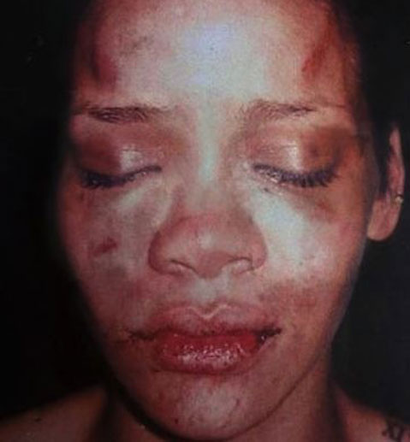
Retrieved from TMZ.com

Slide 17
It is safe for us to assume that Victim Blaming and Rape culture prevent Attitudes that foster Healthy Relationships

