Slide 1
The Goals of the Oregon Food Bank

Slide 2
Mission/Goals
Mission: To eliminate hunger and it’s root causes… because no one should be hungry
Address policy on aliening hunger
Recognize race and individual health in the community
Distribute 15 million lbs. of reduce by 2019

Slide 3
Origin of The Oregon Food Bank
Oregon food share est. 1982
1988 Oregon Food share merges with Interagency food Bank
1999 USDA claims Oregon worst in hunger and food security
2000 expands food program capabilities

Slide 4
Operations/goals
Collect food resources from community partners and state institutions
Distributes through 21 regional food banks, and 970 partner agencies
Garden Education Programs
Community food organizing activities
Address policy on alleviating hunger
Recognize race and individual health in the community
Distribute 15 million lbs. of produce by 2019

Slide 5
Volunteer work
Food packaging
Community gardens
Food sorting
Facility Work
Group volunteering
Harvest Share at Portland State University
Gardening training

Slide 6
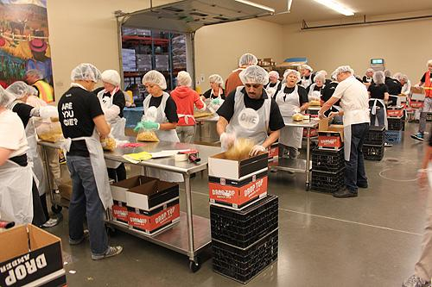
Thank you

