Slide 1
Effective Change Agent Critical Thinking
John Lee
Justin Benfit
November, 2016

Slide 2
Rules
1. You will each be assigned a character. Do not flip your character card over until you are instructed to do so
2. Don’t reveal anything except the name of your character unless asked specifically for more information
3. Do your best to stay true to the description on your character
4. Council amongst everyone is encouraged
5. When asked about your character, answer honestly. Only divulge the information asked
6. The entire group (of all characters revealed up until that point) must remain together at all times
7. After each question, you will have 5 minutes to discuss and submit a creative solution

Slide 3
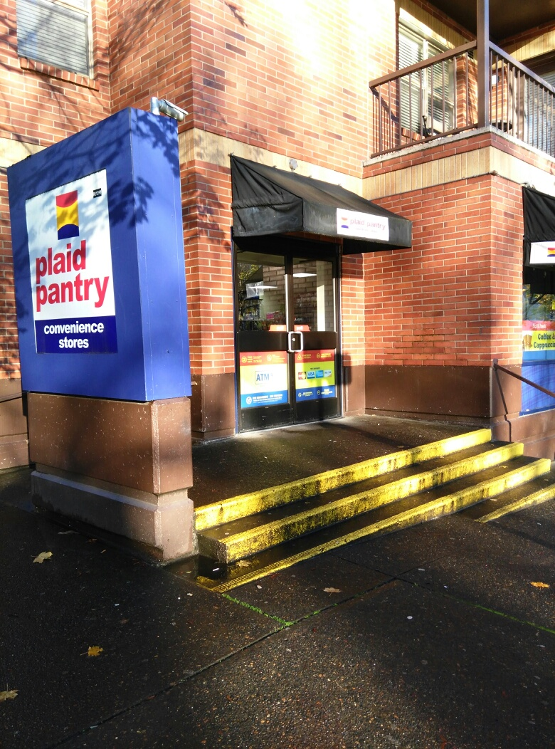
Scene 1
Character 1 near
Portland State
University
When all of
a sudden…
A kidnapping!
Character 2 demands answers from Dracula!
How can we convince Dracula to help?
Notes:
https://4legsgood.files.wordpress.com/2010/06/wfm.jpg

Slide 4
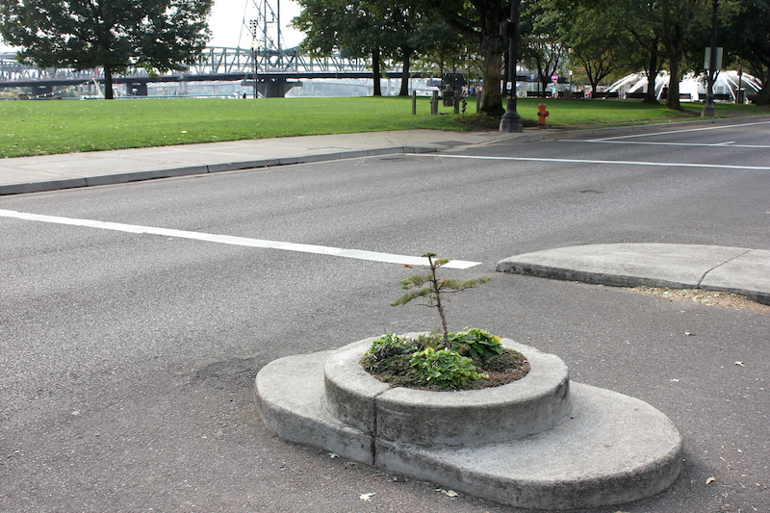
Scene 2
Our characters need help, so they travel to Mill’s End Park where they know Character 3 is at.
Character 3 is with Character 4.
Then out of the blue!
Character 5 appears and steals the Magic School Bus!

Slide 5
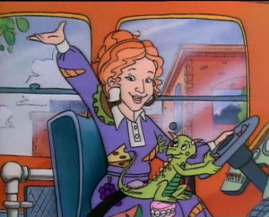
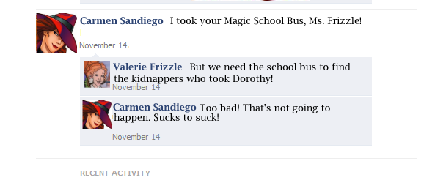
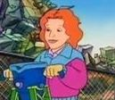
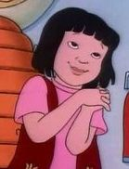
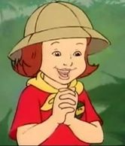
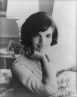
fakebook
Wall
Photos
Flair
Boxes
Valerie Frizzle
Logout
Valerie Frizzle is doing effective change at Mill’s End Park
Wall
Info
Photos
Boxes
Write something…
Share
View photos of Valerie Frizzle (5)
Send Valerie Frizzle a message
Poke message
Information
Networks:
United States
Birthday:
Day Month, Year
Political:
Science
Religion:
Science
Hometown:
Somewhere, Anywhere
Friends
Murph
Arnold P.
How can we convince Carmen to help?
Wanda L.
Phoebe T.
Carlos R.
Notes:
Image Sources: Too many.

Slide 6
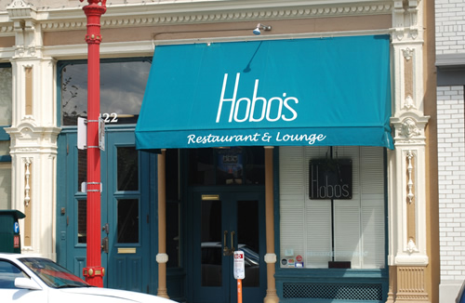
Scene 3
Carmen Sandiego pickpocketed the Kidnappers, but all they had was receipts to Hobo’s
Character 6 is standing at the front of Hobo’s, but isn’t very happy
The tour for the shanghai tunnels is closed. No reason given, no refunds!
Who can help?
How do we find Elmo?
Notes:
Image Source: http://clubfly.com/img/barpic/1653.jpg

Slide 7
Scene 4
Group returns to Hobo’s, but… There’s a angry mob!
It gets worse!
Oh no! Law enforcement!
Oh no! Johnny Appleseed fell asleep!
Goals:
How do we help Johnny Appleseed and Carmen?
How do we get rid of the angry mob?
Notes:
Image Source: https://cmureadme.files.wordpress.com/2015/09/an-angry-mob.png

Slide 8
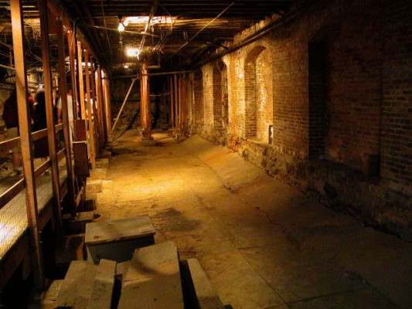
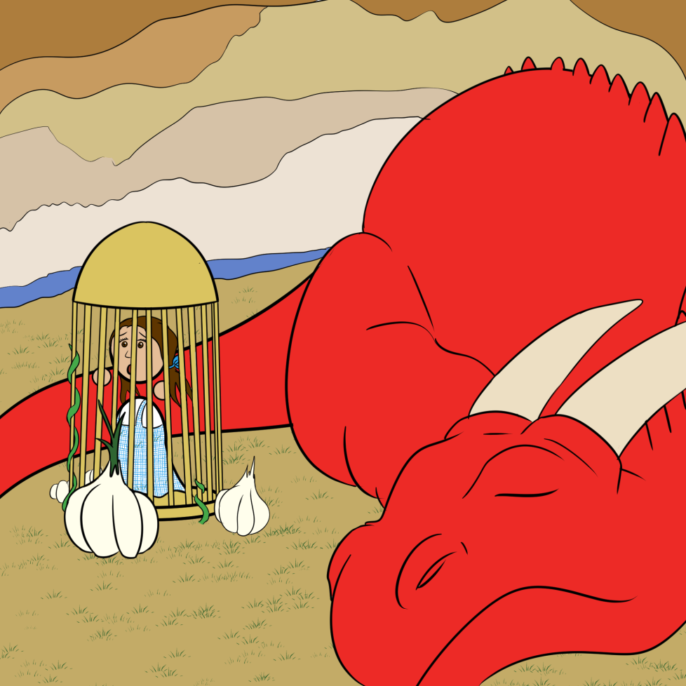
Scene 5
Elmo convinces them to let the group in.
Go into the Shanghai Tunnels and find the kidnappers!
Then, in the darkness…!
The floor falls through!
Oh no! Scarecrow is toast!
How do we distract the dragon and save Dorothy?
Notes:
Image Sources: https://farm7.staticflickr.com/6209/6138744877_d2e32b900b_b.jpg
https://2.bp.blogspot.com/-ozJKrGGz_4w/U1a4Rhhh3PI/AAAAAAAAIiE/nB6qcmSRwqY/s1600/shanghai-tunnels-533x400.jpg

Slide 9
Scene 6
With Dorothy, our characters try to leave the cave
Then, from the shadows…!
The kidnappers capture everyone!
Oh no! Dracula is wrapped in garlic!
Oh no! The Magic School Bus is taken!
Oh no! Elmo’s Tickle Me button is pressed!
How do we escape the kidnappers?
Notes:
https://2.bp.blogspot.com/-ozJKrGGz_4w/U1a4Rhhh3PI/AAAAAAAAIiE/nB6qcmSRwqY/s1600/shanghai-tunnels-533x400.jpg

Slide 10
Scene 7
Dorothy is saved!
Thanks for playing!

