Slide 1
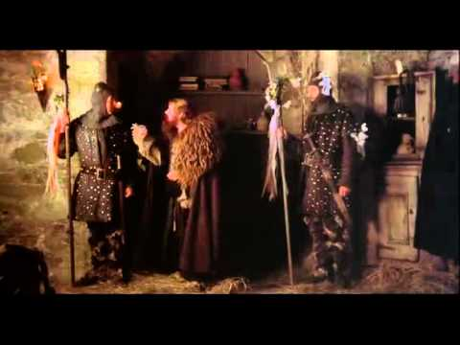
Effective
Communication
Angela Tran & Michelle Hy

Slide 2
What is Effective Communication?
University Studies goal:
“Students will enhance their capacity to communicate in various ways—writing, graphics, numeracy, and other visual and oral means—to collaborate effectively with others in group work, and to be competent in appropriate communication technologies.”
Source: http://www.pdx.edu/unst/university-studies-goals

Slide 3
So what is “communication”...
and how can it be “effective”?

Slide 4
Cups Activity

Slide 5
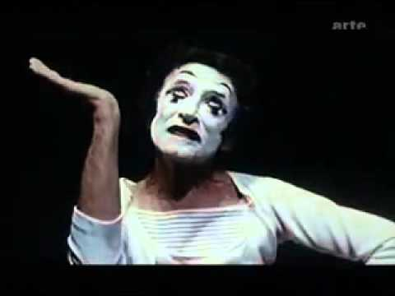
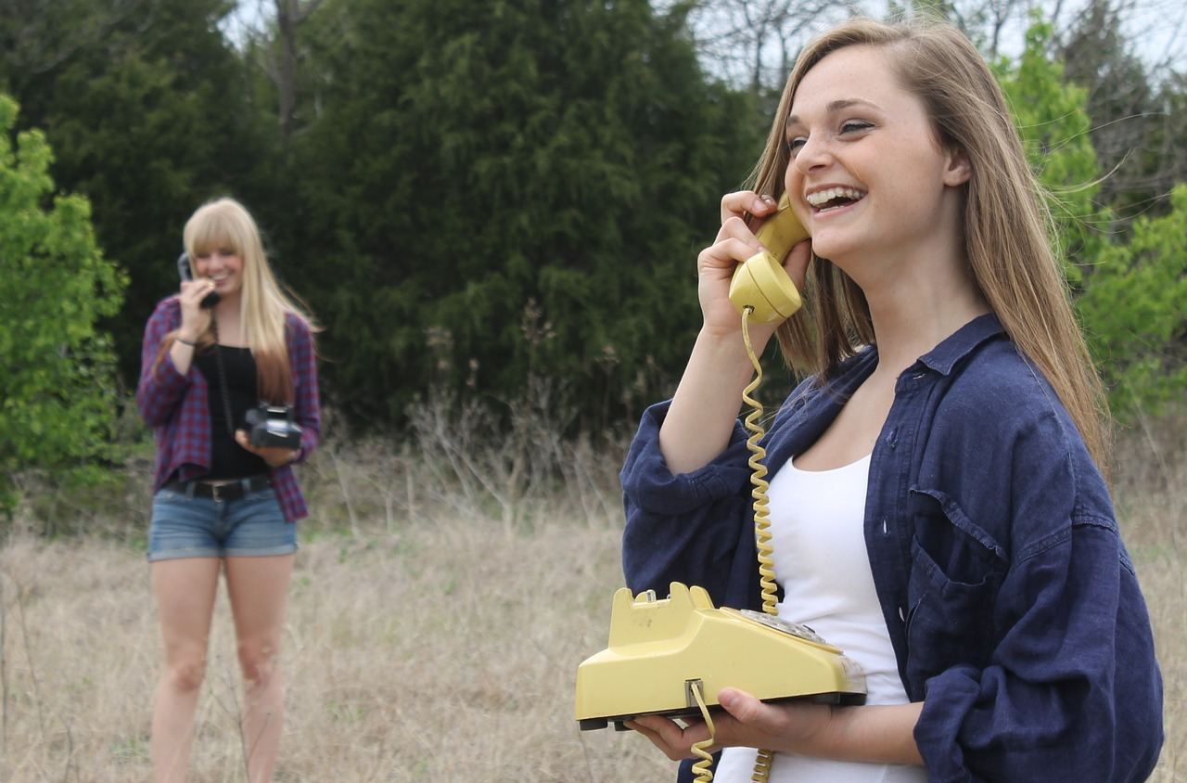
Verbal VS Non-Verbal Communication
https://www.youtube.com/watch?v=naleynXS7yo

Slide 6
Elements of Communication
Receiver
Destination
Message
Source
Sender
Channel
Source: http://www.cls.utk.edu/pdf/ls/Week1_Lesson7.pdf

Slide 7
(Some) Models of Communication
Shannon-Weaver Model
Barlund Model
Transmission VS Constructionist Models
Source: https://en.wikipedia.org/wiki/Models_of_communication

Slide 8
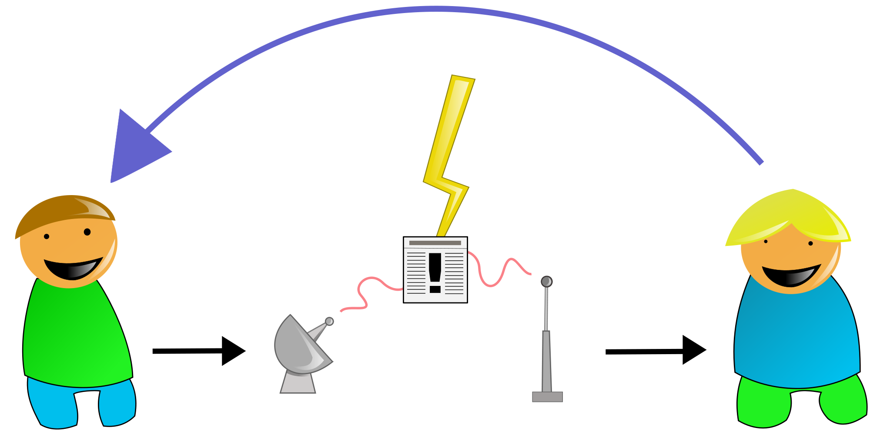
Shannon-Weaver Model (1948)

Slide 9
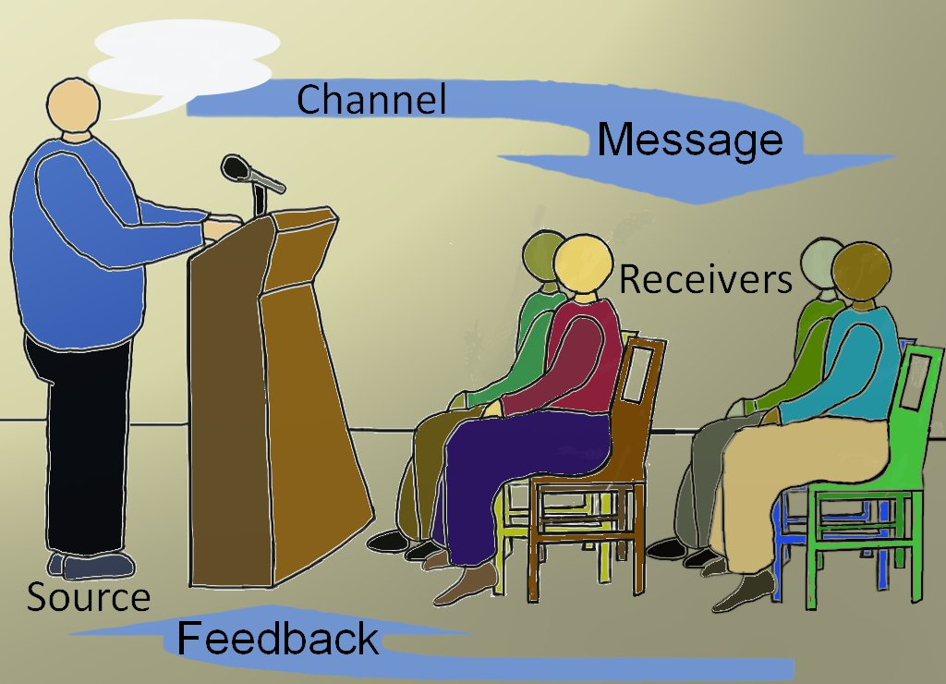
Barnlund Model (1970)

Slide 10
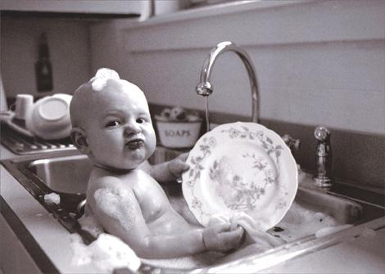
Speech Acts
Locutionary - What was said
“Have you done the dishes yet?”
Illocutionary - What was meant/performed
Translation: “You need to do the dishes”
Perlocutionary - What happened
You did the dishes. Or didn’t.

Slide 11
Transmission VS Constructionist Models
Transmission
Sender → Channel → Receiver Discrete communication units CBS: “Clarity, Brevity, Sincerity” Mechanistic Send message
Constructionist
Sender(s) ←→ Channel(s) ←→ Receiver(s) Collaborative communication flow Performativity of identity Social/historical/cultural context Send/create message simultaneously

Slide 12
TED Talk: 5 Ways to Listen Better
https://www.ted.com/talks/julian_treasure_5_ways_to_listen_better
Also recommended TED Talks:
“This is your brain on communication” - Uri Hasson
“Why you think you’re right - even if you’re wrong” - Julia Galef

Slide 13
Dialoguing Activity

Slide 14
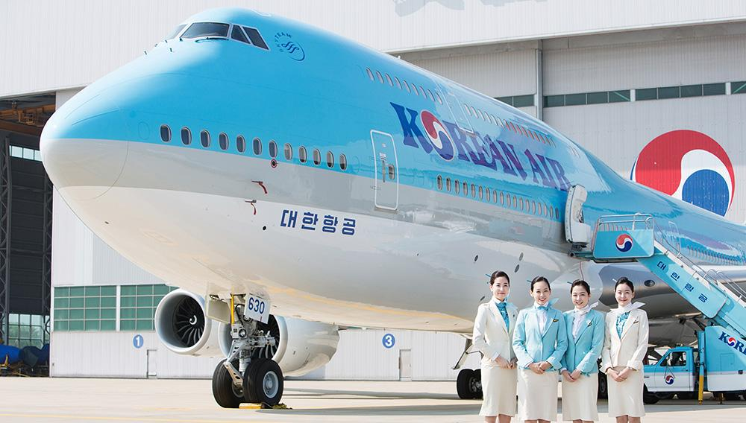
So...Why is Communication Important?
Walk Out, Walk On - Toilet Paper
Outliers by Malcolm Gladwell - Korean Air Flight 801
Communication and community service

