Slide 1
Critical Thinking
By Mac Dennis and Millissa Ravenblade

Slide 2
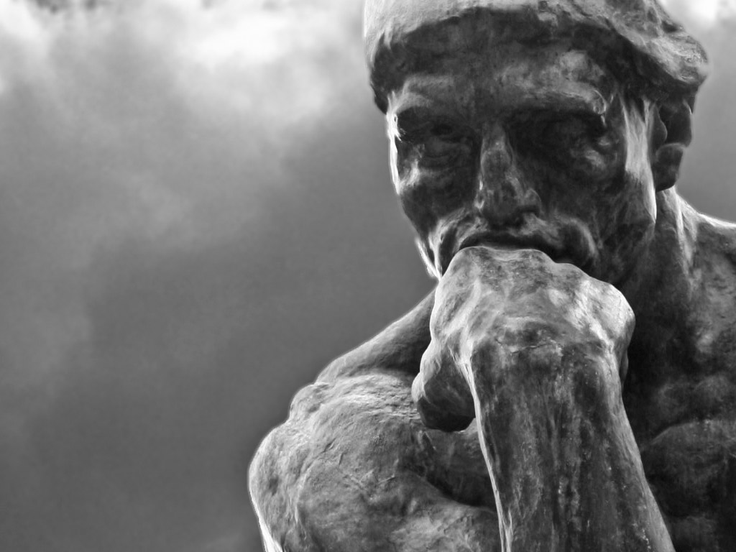
Introduction to Critical Thinking
The art of engaging with topics with the intent of establishing an understanding of the subject. Intelligent debate and decision making requires thoughtful people engaging with the world around them.

Slide 3
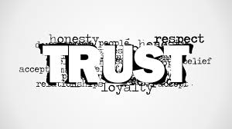
Class Interpretations of Critical Thinking
Trust, but verify
Experiences
Leadership
Thoughtfulness
Curiosity
Creativity
Notes:
I am going to add pictures of what each of these look like or captones that describe this specifically.

Slide 4
Definition of Critical Thinking
In 1941, Edward Glaser - “The ability to think critically, as conceived in this volume, involves three things:
An attitude of being disposed to consider in a thoughtful way the problems and subjects that come within the range of one's experiences
Knowledge of the methods of logical inquiry and reasoning
Some skill in applying those methods.
Critical thinking calls for a persistent effort to examine any belief or supposed form of knowledge in the light of the evidence that supports it and the further conclusions to which it tends.”

Slide 5
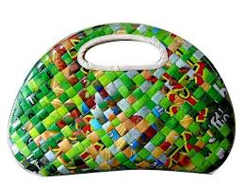
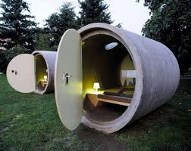
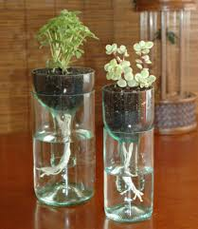
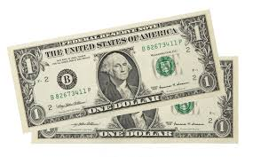
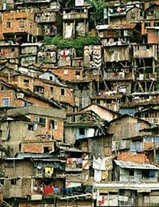
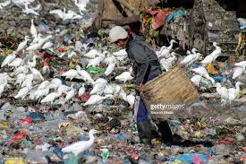
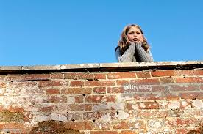
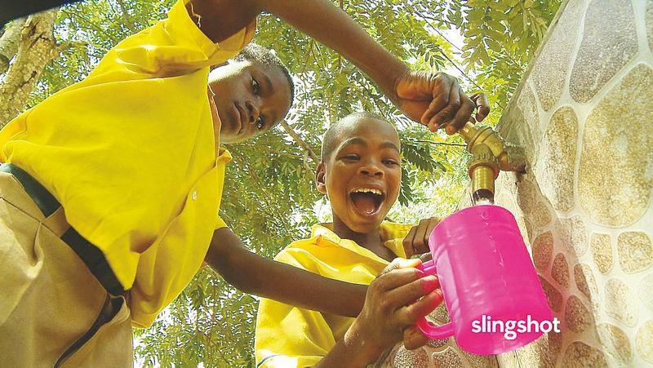
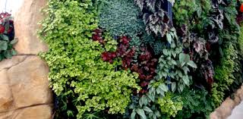
Brazil/South Africa - Walk Out Walk On
Power of play
32% of the population lives on 2 dollar or less a day.
Constructing a staircase.
Reuse of materials.
From Problem to Place
“Start anywhere - follow it everywhere!”
Vertical crops.
“Willow wall” - water purifying.

Slide 6
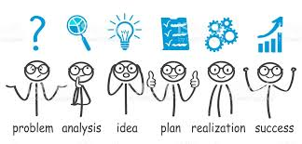
Processes of Attaining Problem Solutions
General requirements to recognize problems:
to find workable means for meeting those problems
to gather and marshal pertinent information
to recognize unstated assumptions and values
to comprehend and use language with accuracy, clarity, and discrimination
to appraise evidence and evaluate arguments
to interpret data in context
Notes:
All of these came from Edward Glasier!

Slide 7
Continued...
to appraise evidence and evaluate arguments
to recognize the existence (or non-existence) of logical relationships between propositions
to draw warranted conclusions and generalizations,
to put to test the conclusions and generalizations at which one arrives
to reconstruct one's patterns of beliefs on the basis of wider experience
to render accurate judgments about specific things and qualities in everyday life
Notes:
All of these came from Edward Glasier!

Slide 8
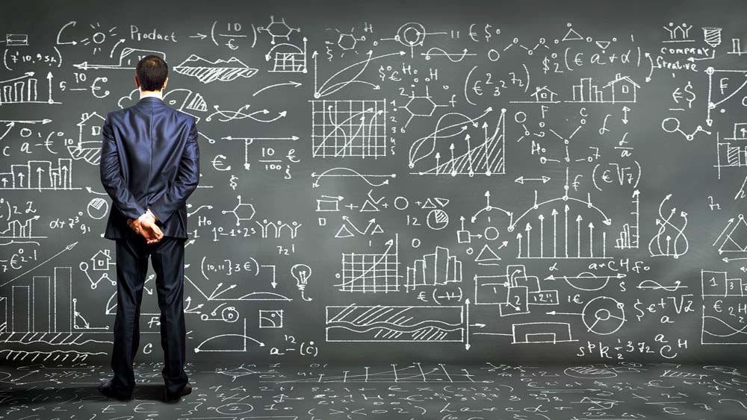
Advantages to Engaged Critical Thinking
One of the main advantages to engaged critical thinking is the ability to objectively investigate topics and concepts that are different from your own intrinsic views.
Political
Religious
Ethical

Slide 9
Discussion
If you feel comfortable with it, tell a story about engaging with someone or something that held a different view from your own.
How do you stay objective?
Have you been the one to find the solution?
What do you find most challenging about the process of critical thinking?

Slide 10
Critical Thinking
By Mac Dennis and Millissa Ravenblade

Slide 11
Introduction to Critical Thinking
The art of engaging with topics with the intent of establishing an understanding of the subject. Intelligent debate and decision making requires thoughtful people engaging with the world around them.

Slide 12
Class Interpretations of Critical Thinking
Trust, but verify
Experiences
Leadership
Thoughtfulness
Curiosity
Creativity
Notes:
I am going to add pictures of what each of these look like or captones that describe this specifically.

Slide 13
Definition of Critical Thinking
In 1941, Edward Glaser - “The ability to think critically, as conceived in this volume, involves three things:
An attitude of being disposed to consider in a thoughtful way the problems and subjects that come within the range of one's experiences
Knowledge of the methods of logical inquiry and reasoning
Some skill in applying those methods.
Critical thinking calls for a persistent effort to examine any belief or supposed form of knowledge in the light of the evidence that supports it and the further conclusions to which it tends.”

Slide 14
Brazil/South Africa - Walk Out Walk On
Power of play
32% of the population lives on 2 dollar or less a day.
Constructing a staircase.
Reuse of materials.
From Problem to Place
“Start anywhere - follow it everywhere!”
Vertical crops.
“Willow wall” - water purifying.

Slide 15
Processes of Attaining Problem Solutions
General requirements to recognize problems:
to find workable means for meeting those problems
to gather and marshal pertinent information
to recognize unstated assumptions and values
to comprehend and use language with accuracy, clarity, and discrimination
to appraise evidence and evaluate arguments
to interpret data in context
Notes:
All of these came from Edward Glasier!

Slide 16
Continued...
to appraise evidence and evaluate arguments
to recognize the existence (or non-existence) of logical relationships between propositions
to draw warranted conclusions and generalizations,
to put to test the conclusions and generalizations at which one arrives
to reconstruct one's patterns of beliefs on the basis of wider experience
to render accurate judgments about specific things and qualities in everyday life
Notes:
All of these came from Edward Glasier!

Slide 17
Advantages to Engaged Critical Thinking
One of the main advantages to engaged critical thinking is the ability to objectively investigate topics and concepts that are different from your own intrinsic views.
Political
Religious
Ethical

Slide 18
Discussion
If you feel comfortable with it, tell a story about engaging with someone or something that held a different view from your own.
How do you stay objective?
Have you been the one to find the solution?
What do you find most challenging about the process of critical thinking?

Slide 19
References
Wheatley, Margaret J., and Deborah Frieze. Walk out, Walk on: a Learning Journey into Communities Daring to Live the Future Now. Berrett-Koehler, 2011
Edward M. Glaser, An Experiment in the Development of Critical Thinking, Teacher’s College, Columbia University, 1941(https://www.criticalthinking.org/pages/defining-critical-thinking/766) - different page need citation but is related to this one.
https://www.gettyimages.co.uk/detail/photo/girl-looking-over-wall-resting-head-in-high-res-stock-photography/200512162-001
www.artistic-recycling.com
http://youreasygarden.com/vertical-gardening-gets-real/

Slide 20
References
Wheatley, Margaret J., and Deborah Frieze. Walk out, Walk on: a Learning Journey into Communities Daring to Live the Future Now. Berrett-Koehler, 2011
Edward M. Glaser, An Experiment in the Development of Critical Thinking, Teacher’s College, Columbia University, 1941(https://www.criticalthinking.org/pages/defining-critical-thinking/766) - different page need citation but is related to this one.
https://www.gettyimages.co.uk/detail/photo/girl-looking-over-wall-resting-head-in-high-res-stock-photography/200512162-001
www.artistic-recycling.com
http://youreasygarden.com/vertical-gardening-gets-real/

