Slide 1
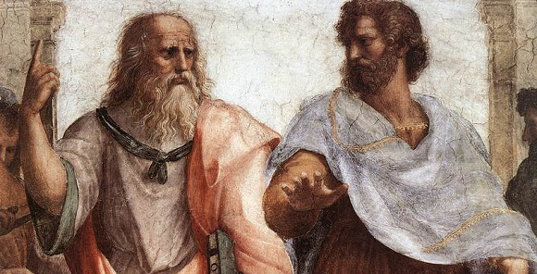
Critical Thinking
Consistency, ethics, and belief.
Why be engaged?

Slide 2
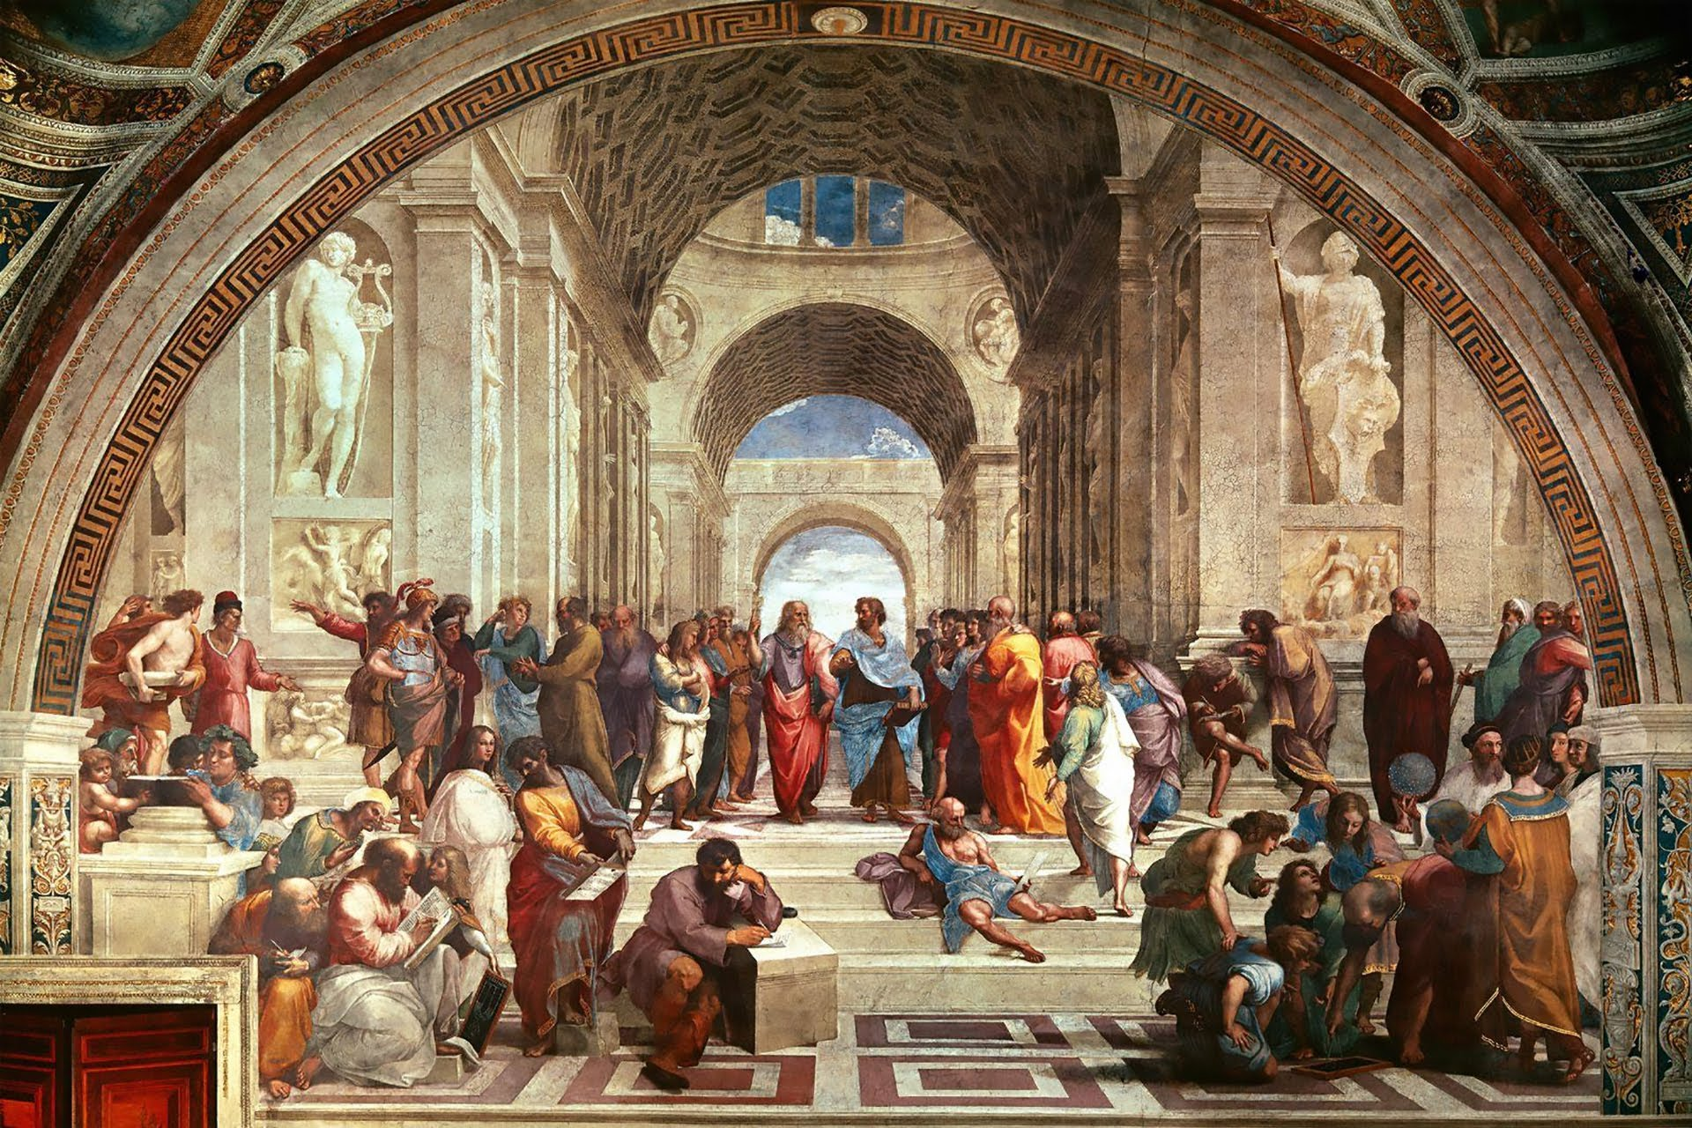

Slide 3
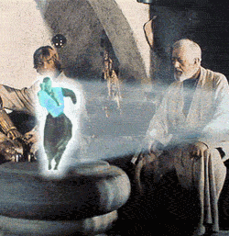
You’re my only hope !

Slide 4
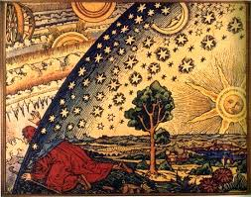
What is Critical Thinking?
Critical thinking is Modelling. Propositions are made in attempt to functionally represent the world. For predicting. It’s taxonomic.
Critical thinking is Testing. Theories are broken into propositions, and their truth is tested.
Critical thinking is reflective. A process of identifying and interpreting assumptions.
The humanist whom no beliefs constrained grew so broad-minded he was scatterbrained.
J. V. Cunningham

Slide 5
Book Keeping
Arguments: Proposition sets that compose a view point or reason for belief.
Deductive: An argument in which the conclusion must result from the propositions, usually by way of definition.
Ampliative: An argument that provides a reason to believe something is likely, or possible.

Slide 6
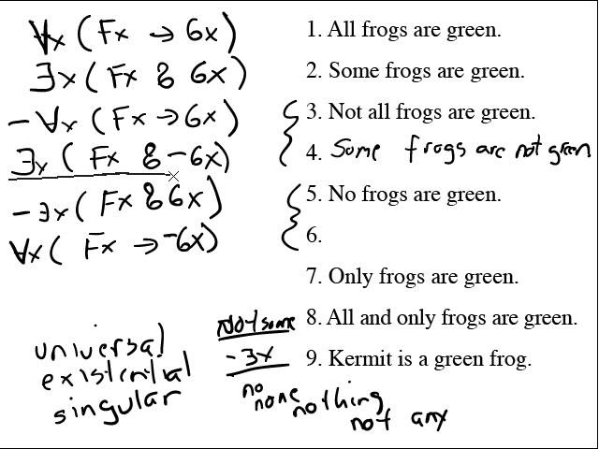
Consistency
Consistency is a term in logic, it means that propositions are not contradictory.
In logic a proposition, is reduced to symbolic form. Often called an argument.
A set of propositions is held to be consistent if it contains no contradictions.

Slide 7
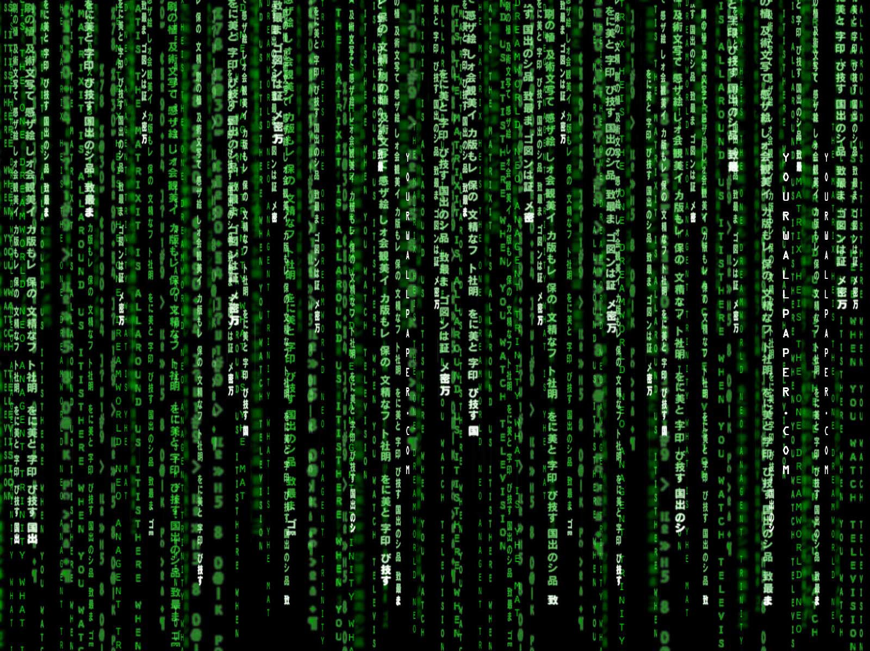
Modeling: Syntax and Semantics
Sets of propositions compose arguments.
The syntax of these arguments may be defined as the rules that govern the communication of ideas. The grammar.
The meaning conveyed in a given symbol is its Semantic value.
Critical thinking can be understood as an attempt to create a syntax semantic pairing that captures our understanding, or predicts the future.

Slide 8
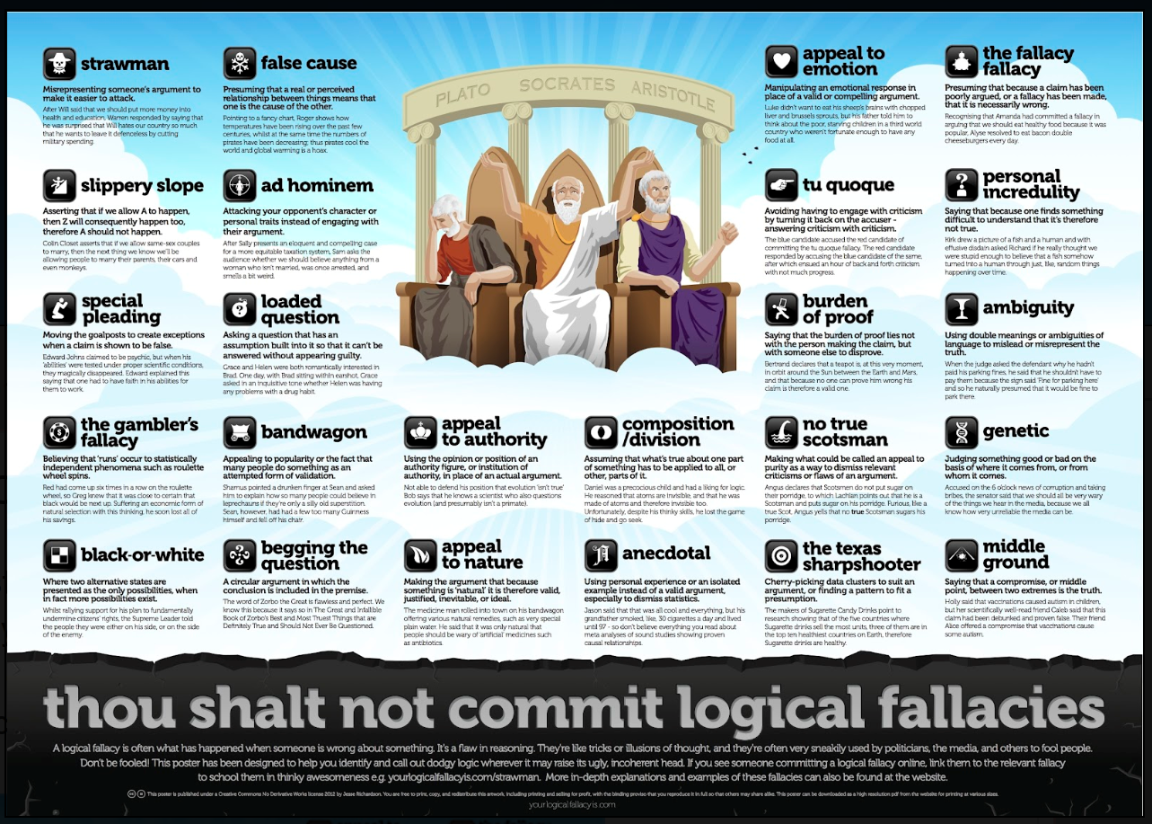
What about Belief?
You’re not supposed to have inconsistent beliefs. That is if your propositions contain contradictions they have not produced a consistent model of the world.
Often times inconsistent belief (proposition) sets are described as containing logical fallacies. An extensive list of these exists...
You’re only supposed to believe things that are consistent.

Slide 10
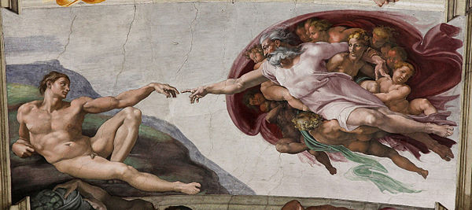
A Correspondence Theory of Truth
All our propositions model the world!

Slide 11
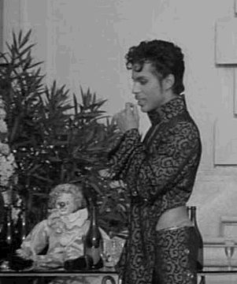
You can’t make an ought out of an is!
Knowing the way the world is, doesn't suggest what we should do.
There could be many equally correspondent descriptions of the world.
A totally correspondent description just is the world. Which is to say, that’s all we have access to. The matrix.
It’s a construction I tell ya! We have to spend our whole lives figuring out what’s real for ourselves! And we’re all alone!

Slide 12

Ethics: What should we do?
Supposing some correspondence theory of truth exists (Science), and we can model the world with it, what should we do?
Will sufficient knowledge of how things work reveal what we should do?
“I’m Mark’s alone!” you swore. Given cause to doubt you, I think less of you, dear. But more about you.”
John Frederick Nims

Slide 13
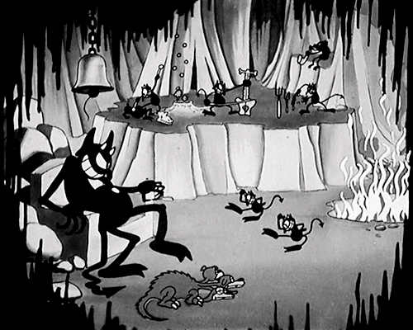

Slide 14
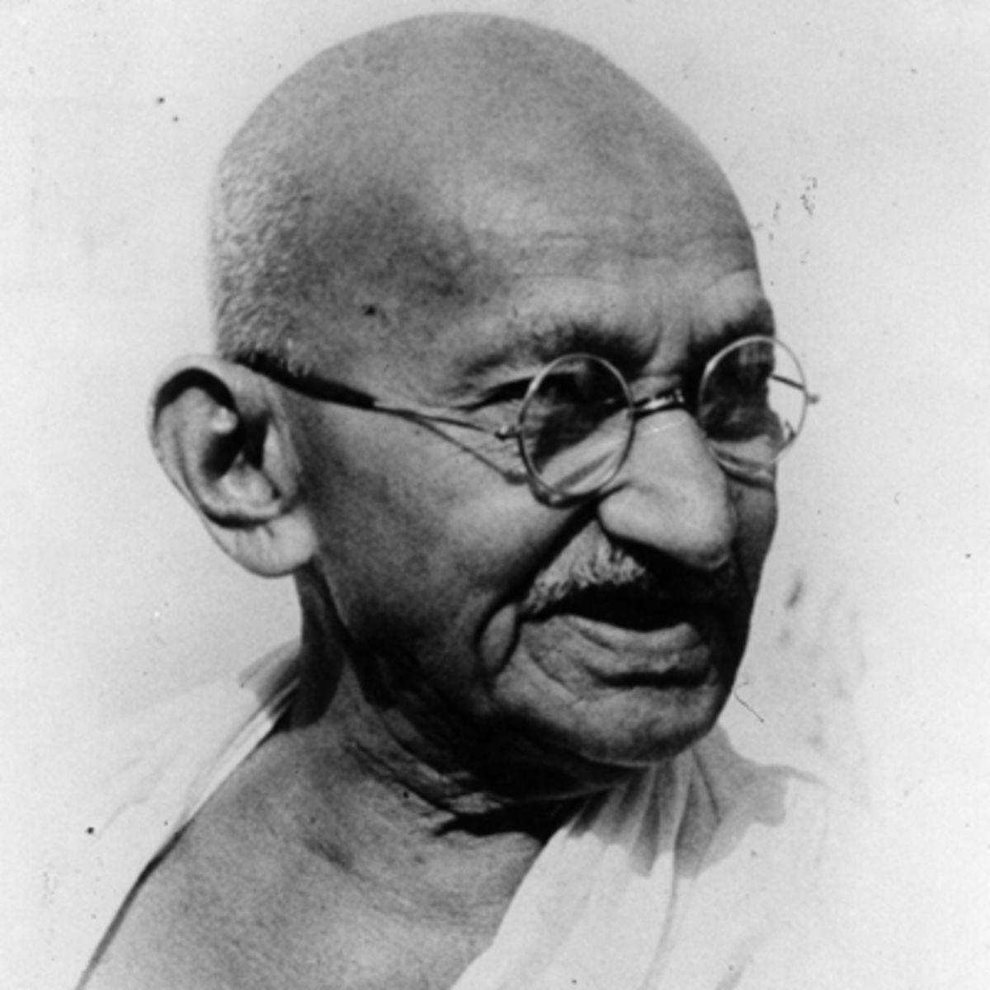
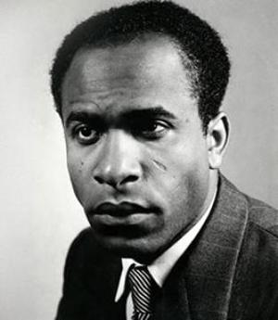
“Nonviolence is the greatest weapon at the disposal of mankind. It is mightier than the mightiest weapon of destruction designed by the ingenuity of man”
-Ghandi
Lets
Talk
“Violence is man re-creating himself.”
-Frantz Fanon

