Slide 2
Fr. Richard Berg, C.S.C., found out over 25 years ago, in Portland’s Old Town neighborhood that there were hundreds and hundreds of people living in single room occupancy hotel rooms, many of whom where isolated from the community and struggling with poverty, mental illness and addiction. So Fr. Berg that was a call to action.
In 1991, Father Richard Berg commissioned a study that found that isolation was the most critical factor facing those living in SRO’s. Maybelle Center for Community, began with a group of dedicated volunteers organized by Fr. Berg. They were determined to make a difference in the lives of their neighbors, one-by-one. And it worked.
WHAT WAS INTUITION YEARS AGO, IS NOW BEEN SUPPORTED BY RESEARCH.
Loneliness has now surpassed obesity as a predictor of early death. In fact loneliness is as harmful to your body as smoking 15 cigarettes a day.
A Brief History

Slide 3
The Maybelle Center’s vision is to build a healthier community and world. We believe that unconditional caring has a profound and lasting impact on the health of individuals and communities.

Slide 4
Many people feel marginalized by the larger Portland community and often lack family or friends with whom to share life’s joys and struggles. They face life, and it’s many opportunities and challenges alone. In the absence of authentic companionship and community, loneliness often turns to hopelessness, as people question the value of their lives as human beings.

Slide 5
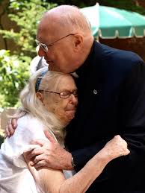
Our Values
No one deserves to live in isolation
As people, we share more similarities than differences
Every person has inherent worth and dignity
The health of our community can be measured by how we care for each other

Slide 6
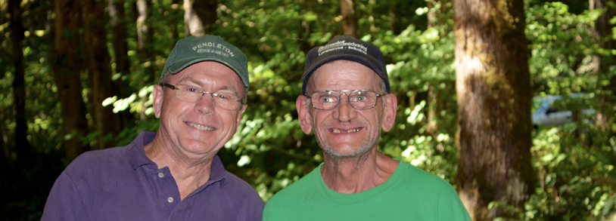
Maybelle Center reduces loneliness and isolation by providing meaningful connection through volunteer visits, our community room, individual member support, and housing. Because of donors and volunteers, each year over 500 members have a community at Maybelle Center where they are loved and­­ accepted, right where they are.

Slide 8
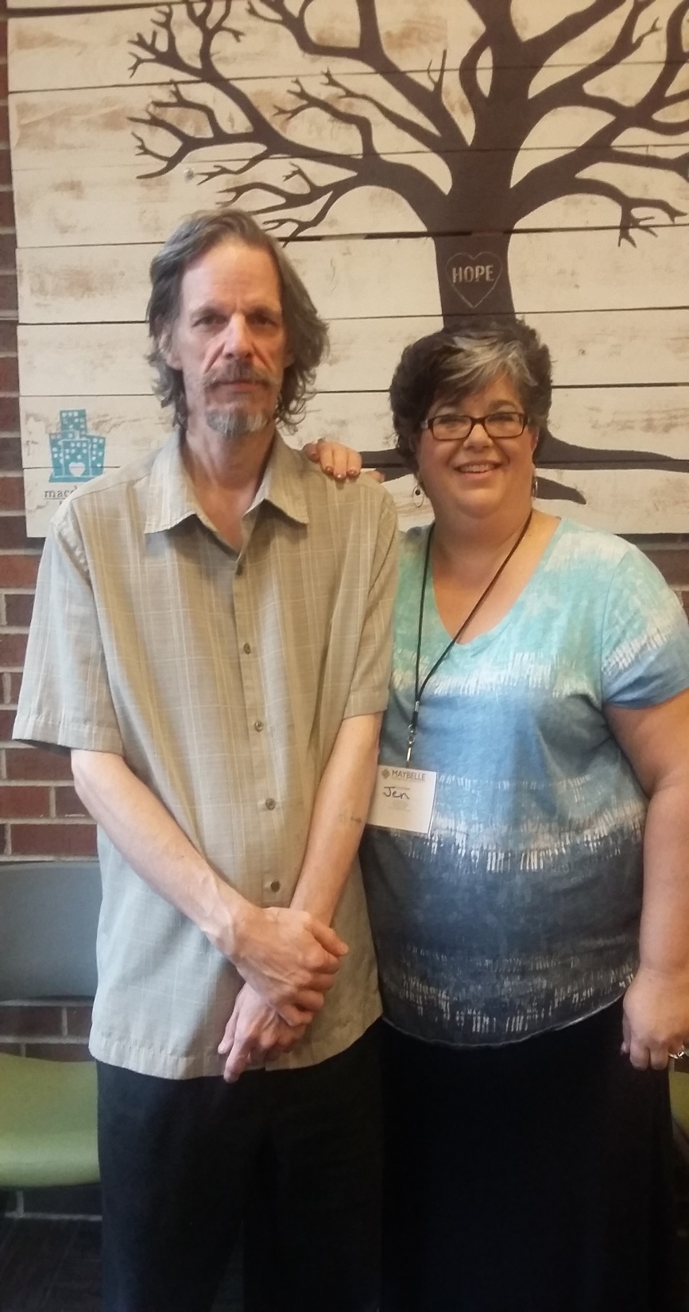
A core belief at Maybelle Center that centers our work is that every person has inherent worth and dignity. That no matter someone’s past, or present, they have a need to belong, to be understood, to be cared for, and to have people in their lives they can trust.

