Slide 1
AQUATIC CLASSES & EVENTS

Slide 2
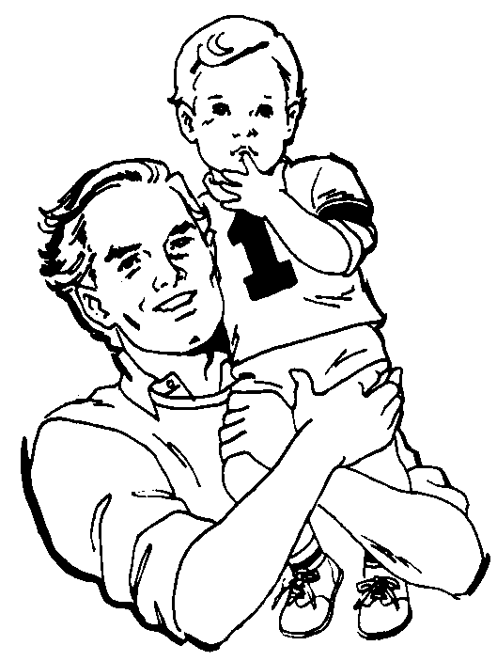
WHY SHOULD MY CHILD BE A SWIMMER?
Outstanding activity for people of all ages
Promotes fitness and teaches a child to strive for physical achievement
Exciting individual and team sport activity
Technical and specialized activity involving extensive skill development
Healthy "lifetime" activity. Participants may be 1 or 101 years old

Slide 3
WHY SHOULD MY CHILD BE A SWIMMER? (continued)
Relatively injury free in comparison to other youth sports.
Teaches the life lessons of sport and sportsmanship which include learning to deal with winning and losing, as well as working with officials, teammates and coaches.
Motivates participants to strive for self improvement and teaches goal orientation.
Cultivates a positive mental attitude and high self-esteem.
Learning to swim can prevent drowning.

Slide 4
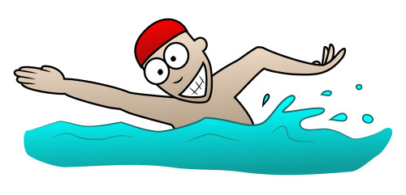
SPECIAL EVENTS: 1 MILE SWIM RELAY
Information:
Teams of 2-4 swimmers
1 mile= 36 laps (1 lap up and back)
Open to anyone, swimming experience preferred.
Why Participate?
Prizes for winning teams
Raffle prizes
Snacks
Fun competition

Slide 5
BENEFITS OF AQUATIC CLASSES:
Swimming is an aerobic exercise which will help you maintain a healthy heart.
Low impact exercise on joints.
Increases muscular strength and endurance.
Recruits all major muscle groups.

Slide 6
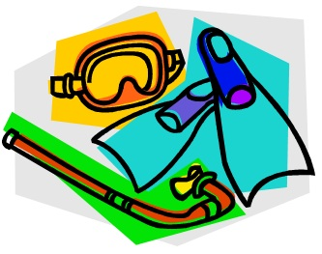
SWIMMING GEAR AVAILABLE:
Goggles
Kickboards
Fins
Pull Buoys
Swim paddles
Life jackets
Zero gravity suits
Ax Training Shoes

Slide 7
POOL RULES:
Obey all posted rules.
Dive only where diving is allowed.
Never jump on someone or push someone into the pool.
Never pretend someone is drowning.
No running off the pool deck.
Obey the lifeguard. He or she is there to keep you safe.

Slide 8
BENEFITS OF BEING A LIFEGAURD:
Warm summer job that pays.
Develop leadership and discipline skills.
Learn life-saving techniques in and out of the pool.
Teach other swimmers about water safety.

