Slide 1
Social Responsibility
Samantha Small, Stefanie Steele, Zachary Learned

Slide 2
https://bctf.ca/publications/NewsmagArticle.aspx?id=7824

Slide 3
What does social responsibility mean to you? How important is it?
Notes:
Stefanie

Slide 4
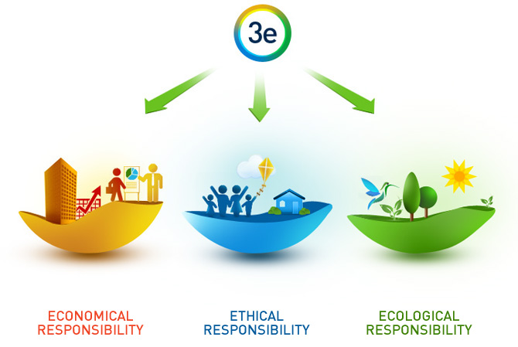
What examples of socially responsible behavior have you observed? In what areas do you see needs improvement?
Notes:
Zach

Slide 5
How can we support each other to be socially responsible?
Notes:
Samantha

Slide 6
Foundations of Social Responsibility
The phrase “ethical issues and social responsibility” refers to the impact and value of individuals and their choices on society – intellectually, socially, and personally.
When does it apply?
It should be incorporated into daily actions/decisions, particularly ones that will have an effect Individually and group actions that affect others and/or the environment
Every individual has a responsibility to act in manner that is beneficial to society and not solely to the individual.
Businesses have developed a system of social responsibility that is tailored to their company environment
https://www.pachamama.org/social-justice/social-responsibility-and-ethics
Notes:
Zach

Slide 7
Intellectually
Examples of Intellectual Social Responsibility
Social Media/ Movies/ Cartoons such as Captain Planet and Magic School Bus
Universidad de la Tierra from Walk Out Walk On
“Trans-local learning”
Discerning what is false information
Notes:
Samantha
Being educated in knowing and understanding what is happening in the community and what part we can play
Learning and educating self and others
Taking advantage of what is known
Apply what we have learned from schooling
Our responsibility to teach what we know
Cartoons with role models
Pg 25

Slide 8
Socially
Community Service
Washington County Suggestions:
My New Red Shoes
Good Neighbor Center
Community Partners for Affordable Housing
Cedar Mill Library
Cat Adoption Team
Oregon Food Bank (Beaverton)
The Media Foundation
Portland Area Suggestions:
The Rebuilding Center
Portland Parks & Recreation
Portland Metro
Forest Park Conservancy
Oregon Food Bank
Oregon Humane Society
https://www.handsonportland.org/Court_Ordered_Volunteering
Notes:
Stefanie

Slide 9
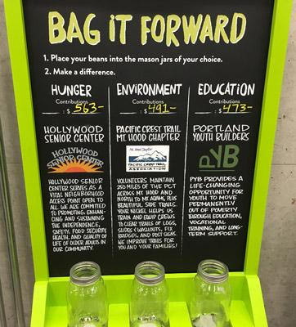
Socially
Community Involvement
The Oregon Public House
Toms
New Seasons Market
Notes:
Stefanie
Oregon public house charities
BUILDING BLOCKS TO SUCCESS
BB2S is focused on inspiring and empowering youth through exposure to Science, Technology, Engineering and Math (STEM). BB2S serves youth identified as atrisk, underserved, underrepresented, and has a priority focus on youth of color. BB2S aims to get youth excited about STEM through creative, fun, team-building, and educational STEM-related activities. The curriculum used is hands-on and teaches a fundamental set of skills that promote life-long learning.
CALL TO SAFETY
Call to Safety believes that everyone deserves a life free of domestic and sexual violence. In addition to being Oregon’s largest crisis line for survivors, they also offer hospital response after a sexual assault, case management, and support groups. Call to Safety’s advocacy work has shown that each survivor knows what options are best for them, and CTS makes it their job to support survivors’ choices and plans.
GROWING GARDENS
Growing Gardens uses the experience of growing food in schools, backyards and correctional facilities to cultivate healthy, equitable communities. Through hands-on learning, people across Oregon learn skills, build leadership, and grow in a way that is true to themselves.
THE FAMILY ROOM
The Family Room’s mission is to provide a homelike visitation setting for families separated in the foster care system. We increase both the quantity and quality of supervised time families spend together with the goal of increasing the likelihood that children can return to their birth parents safely, expediently, and sustainably.
THE ODD MAN INN
Odd Man Inn is a nonprofit refuge for wayward, abandoned, neglected, or otherwise displaced animals of many different species. We help animals get the care and socialization they need on their way to a forever family. We work beside and serve our surrounding communities, animal shelters, and youth organizations. We foster and encourage compassion for all living things.
ROCK 'N' ROLL CAMP FOR GIRLS
The Rock ’n’ Roll Camp for Girls serves girls, transgender, and gender nonconforming youth (regardless of identity), through a transformative week of music creation and performance. RnRC4G builds campers' self-esteem and confidence by creating leadership opportunities, cultivating a supportive community of peers and mentors, and encouraging the pursuit of social justice and the development of life skills.

Slide 10
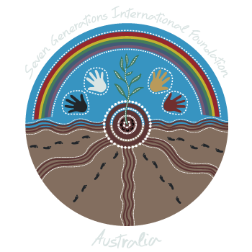
7th Generation Principle
“In our every deliberation, we must consider the impact of our decisions on the next seven generations.”
An ancient Iroquois philosophy based on decisions made today resulting in a sustainable world 7 generations into the future.
https://www.youtube.com/watch?v=YWVVYAHHeoo
Notes:
Stefanie

Slide 11
Personally
The Golden Rule
Humanism Philosophy
"Social responsibility-that is, a personal investment in the well-being of others and of the planet-doesn't just happen. It takes intention, attention, and time." — Sheldon Berman, "Educating for Social Responsibility," Educational Leadership, November 1990
Notes:
Samantha
Change must start with yourself- can not expect change socially if you can not change
http://www.thinkhumanism.com/the-golden-rule.html

Slide 12
What Would You Do?
http://abcnews.go.com/WhatWouldYouDo/video/litterbug-discards-trash-portland-park-36674413
Notes:
Zachary

Slide 13
Real World Examples of Issues Related to Social Responsibility

Slide 14
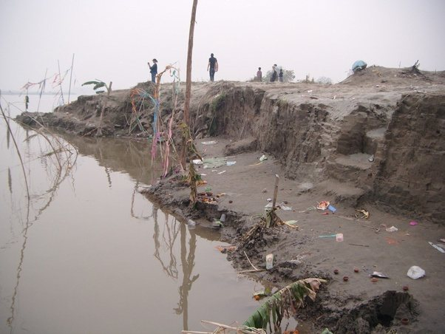
Ganges River Pollution
https://www.youtube.com/watch?v=8Q5Ujc6IbDc

Slide 15
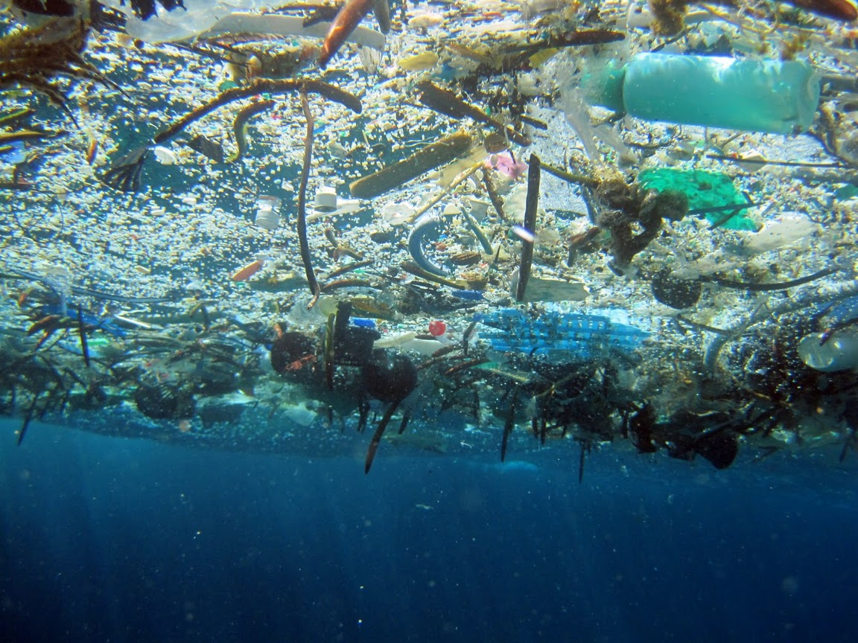
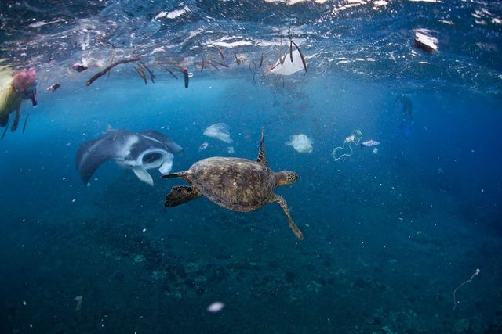
Great Pacific Garbage Patch: One of many areas in the ocean where marine debris naturally concentrates because of ocean currents
https://www.youtube.com/watch?v=_6xlNyWPpB8

Slide 16
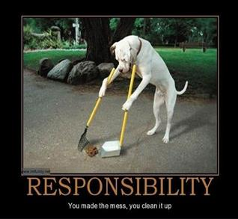
Thank you!

