Slide 1
Voting
We can be the difference

Slide 2
Why should we vote?
Because bad politician are elected by good people who do not VOTE

Slide 3
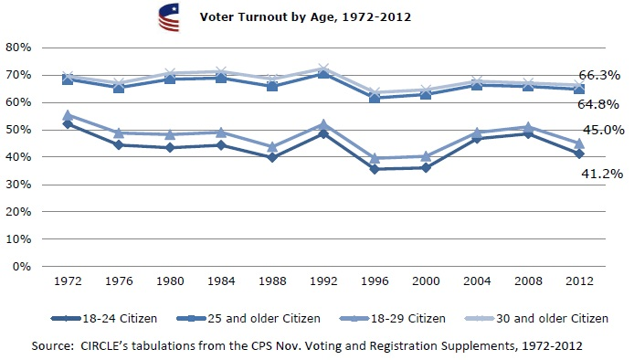
Who votes in the united states?

Slide 4
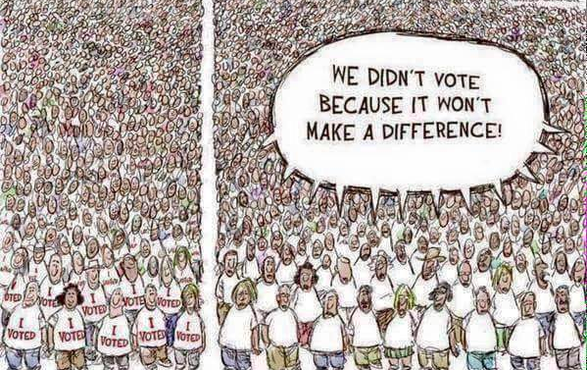
We are responsible

Slide 5
We can vote on state level laws that can effect our community and the whole nation at one point.
In Oregon, we are above the national average by 8.5 on voters, we came up to 60.13 percent. We came up in the top 6 states to have the most voters.

Slide 6
If we vote we can be the difference
increase the amount of money that high-income people get taxed on: this way they will participate on giving back the community more money and will help solving some social problems.

Slide 7
The cost of war
Every hour the tax payers pay to support wars about 10.5 million an hour since 2001: this money can be used to help the economic crises and health problems we are suffering now, if we calculate the debt it will be around 1.5 trillion and this number is increasing by the second.

Slide 8
Better our education system
We can vote to free out education, or lower the cost of school. So when we graduate we wont have a lot of debt that will hunt us for awhile. The education debt has reached 1.2 trillion only in student loans

Slide 9
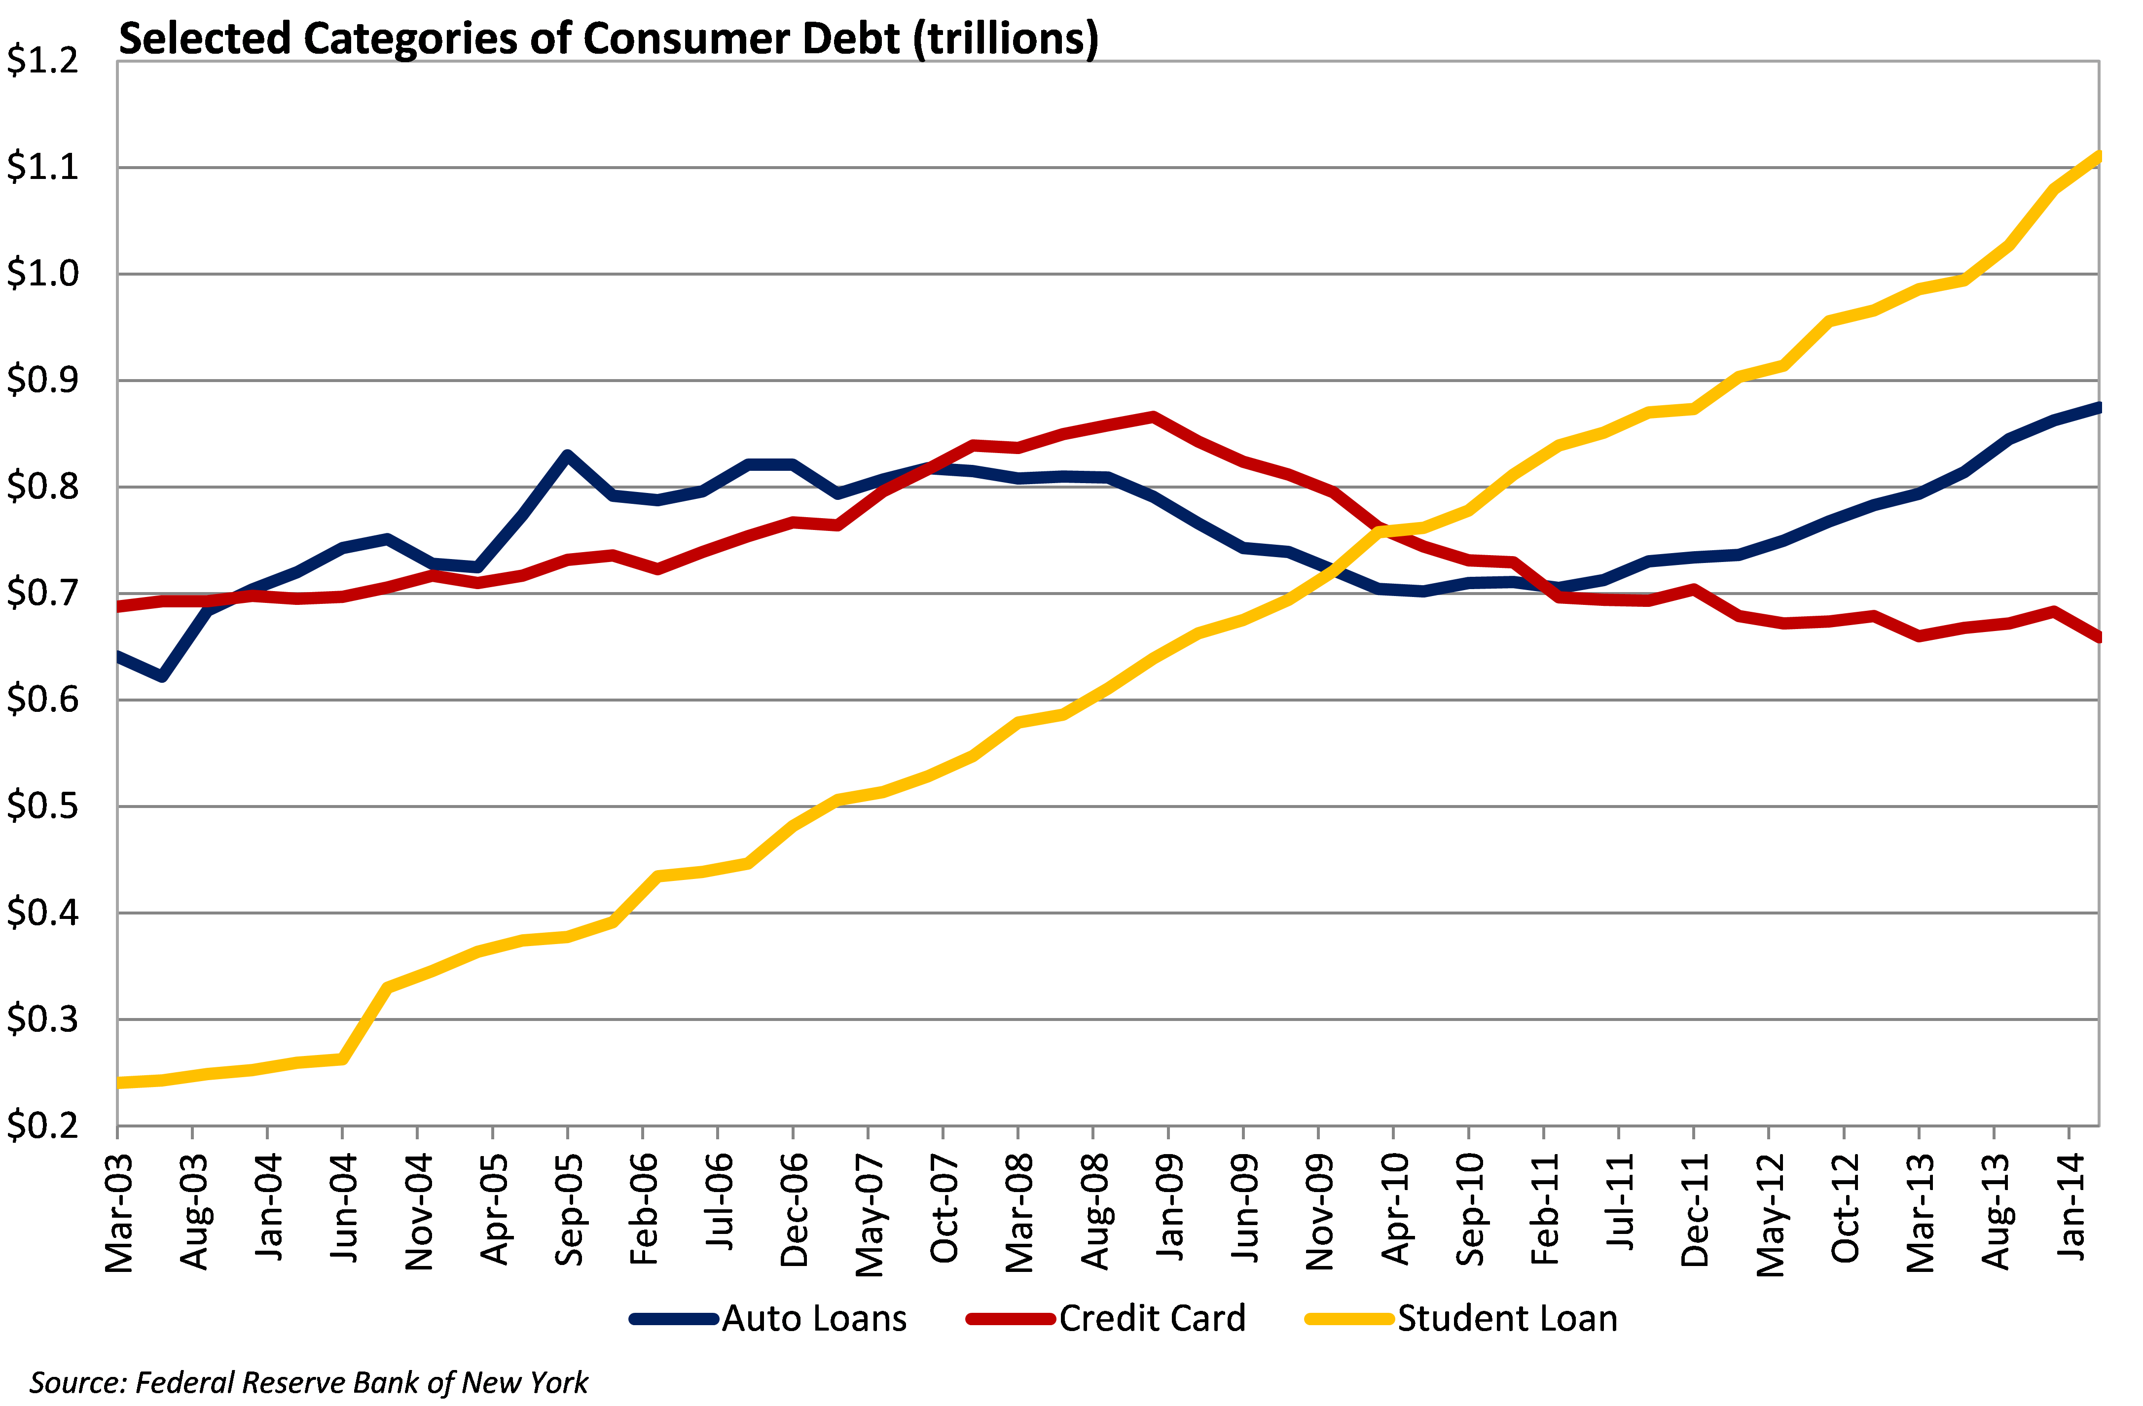
Yellow=student loan debt red=credit card debt blue=installment loan

Slide 10
We have been cutting the health care system from a lot of people, or people who are in the middle will pay so much money to afford health insurance. By Voting, we can decide who to represent us to the government and meet our needs.

Slide 11
Random stats about who is voting
http://america.aljazeera.com/opinions/2015/7/most-americans-dont-vote-in-elections-heres-why.html

